Slide 1
Applied Machine Learning and Data Mining
Week 4: Data Preprocessing
Dr. Alaa Mohasseb

Slide 2
Last Week
Getting Introduced to Data Mining Process (CRISP-DM)
Learn What is Data Understanding
Understanding the Different Characteristics of the Data
Gain an Understanding of the Data Quality Dimensions.

Slide 3
This Week Learning Objectives
Learn What is Data preprocessing?
Identify the importance of data preprocessing
Understand how to apply data Cleaning

Slide 4

Data Preprocessing
Business understanding
Deployment
Data Understanding
Data Mining Process
Evaluation
Data
preparation
Modelling
Notes:
The goal of data pre-processing is to make your data more usable, accurate, and reliable, just as preparing ingredients makes cooking easier and your meal more delicious. It ensures that when you analyze or use your data, you get the best results and insights

Slide 5
What is Data Preprocessing?
Data preprocessing describes any type of processing performed on raw data to prepare it for another processing procedure.
Data preprocessing transforms the data into a format that will be more easily and effectively processed for the purpose of the user.
In an AI context, data preprocessing is used to improve the way data is cleansed, transformed and structured to improve the accuracy of a new model, while reducing the amount of compute required.

Slide 6
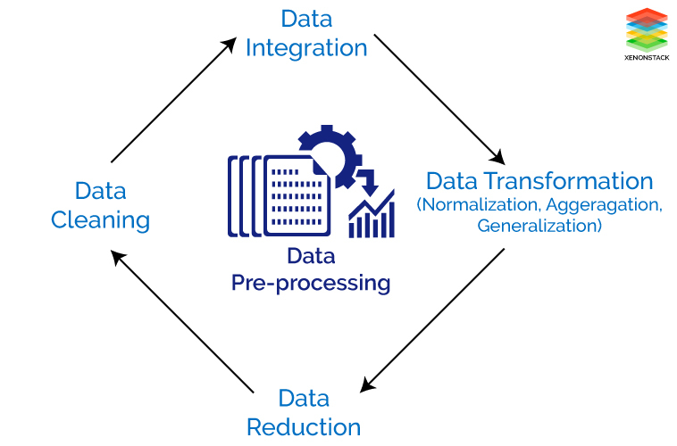
Tasks of Data Preparation / Preprocessing
Data Cleaning
Data Integration
Data Transformation
Data Reduction

Slide 7
Data Preprocessing - Data Cleaning
Data cleaning is applied to remove noise and correct inconsistencies in the data.
Data Cleaning
Remove duplicate or irrelevant observations
Fix structural errors
Filter unwanted outliers
Handle missing data
Notes:
Sometimes, data can be messy, with errors, missing values, or duplicates. Cleaning is like washing and peeling vegetables to make sure they are good to use. In data, it means fixing errors and removing or filling in missing values.

Slide 8
Missing Values
Data is not always available
E.g., many tuples have no recorded value for several attributes, such as customer income in sales data.
Missing data may be due to
equipment malfunction.
inconsistent with other recorded data and thus deleted.
data not entered due to misunderstanding.
certain data may not be considered important at the time of entry.
not register history or changes of the data.
Missing data may need to be inferred.

Slide 9
How missing data can be handled ?
Ignoring the missing record
Filling the missing values manually
limitation: large data set, and missing values are significant, it becomes a time-consuming task.
Filling using computed values
mean, mode or median
Machine Learning or Deep Learning tools and algorithms.
Limitation: it can generate bias within the data as the calculated values are not accurate concerning the observed values.

Slide 10
Noisy Data
Noise: random error or variance in a measured variable.
Incorrect attribute values may due to
faulty data collection instruments.
data entry problems.
data transmission problems.
technology limitation.
inconsistency in naming convention.
Other data problems which requires data cleaning
duplicate records.
incomplete data.
inconsistent data.
Notes:
Noisy data refers to data that contains random or irregular variations in its values, making it more difficult to discern patterns, relationships, or meaningful information from the data. This noise can be caused by various factors, such as errors in data collection, measurement inaccuracies, or even environmental factor
Medical Measurements: In healthcare, patient vital sign measurements, like heart rate or blood pressure, can contain noise due to factors such as patient movement, measurement equipment inaccuracies, or physiological fluctuations.
Social Media Data: Data gathered from social media platforms can be noisy because of the sheer volume of information, including spam, irrelevant content, and variations in language and sentiment analysis.
Image and Video Data: Image and video data can be noisy due to factors like compression artifacts, lighting conditions, or motion blur. This can affect the quality and interpretability of the visual data

Slide 11
How Noisy data could be handled?
Data Binning
In this Data Preparation process sorting of data is performed concerning the values of the neighborhood. This method is also known as local smoothing.
Preprocessing in Clustering
In this approach, the outliers may be detected by grouping similar data in the same group, i.e., in the same cluster.
Machine Learning
A Machine Learning algorithm can be executed for the smoothing of data during Data Preprocessing
For example, Regression Algorithm can be used for the smoothing of data using a specified linear function.
Removing manually
The noisy data can be deleted manually by the human being, but it is a time-consuming Data Preparation process, so mostly this method is not given priority.
Notes:
Let's say you have a dataset of people's ages. The ages vary from 1 to 100. Binning this data could involve grouping the ages into specific ranges, or bins. For example, you might create the following bins:
0-10 years
11-20 years
21-30 year
Let's say you have a dataset of customer purchase behavior, and you want to use clustering to group similar customers together based on their purchase history. You decide to use a k-means clustering algorithm, which aims to group customers into clusters with similar purchasing patterns
Suppose you have a dataset that represents monthly temperatures over several years, and it shows some fluctuations due to daily temperature variations. You want to smooth this data to identify the overall trend in temperature changes.

Slide 12
Inconsistent Data
Data source containing discrepancies between different data items.
Some attributes representing a given concept may have different names in different databases, causing inconsistencies and redundancies.
Naming inconsistencies may also occur for attribute values.
Notes:
For example, in a database tracking customer addresses, "Street" could be recorded as "123 Main St," "123 Main Street," or "123 Main Str."
Friend A calls it "Birthday Date."
Friend B calls it "Date of Birth."
Now, when you want to combine their lists to see if you have any friends with the same birthdays, you get confused because the names are different

Slide 13
How to handle inconsistent data
Manually and perform Data Preparation and analysis properly
Using external references and knowledge engineering tools like the knowledge engineering process.

Slide 14
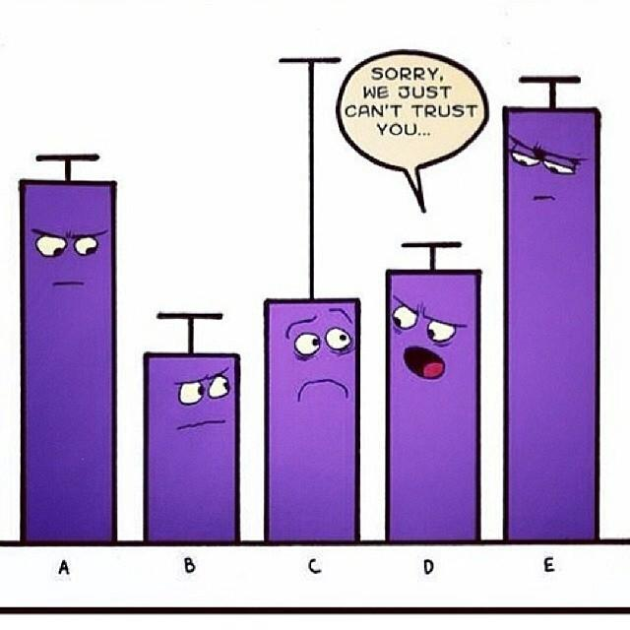
What is an Outlier?
An outlier is a data point that is distant from other similar points.
It is an observation that lies on abnormal observation amongst the normal observations in a sample set of population.
In statistics, an outlier is an observation point that is distant from other observations.
Notes:
In data science, an outlier is an observation or data point that significantly differs from other data points in a dataset. Outliers are values that are unusually high or low compared to the majority of the data and can distort the results of data analysis and statistical modeling. They are often considered as data points that lie far from the central tendency of a dataset, such as the mean or median

Slide 15
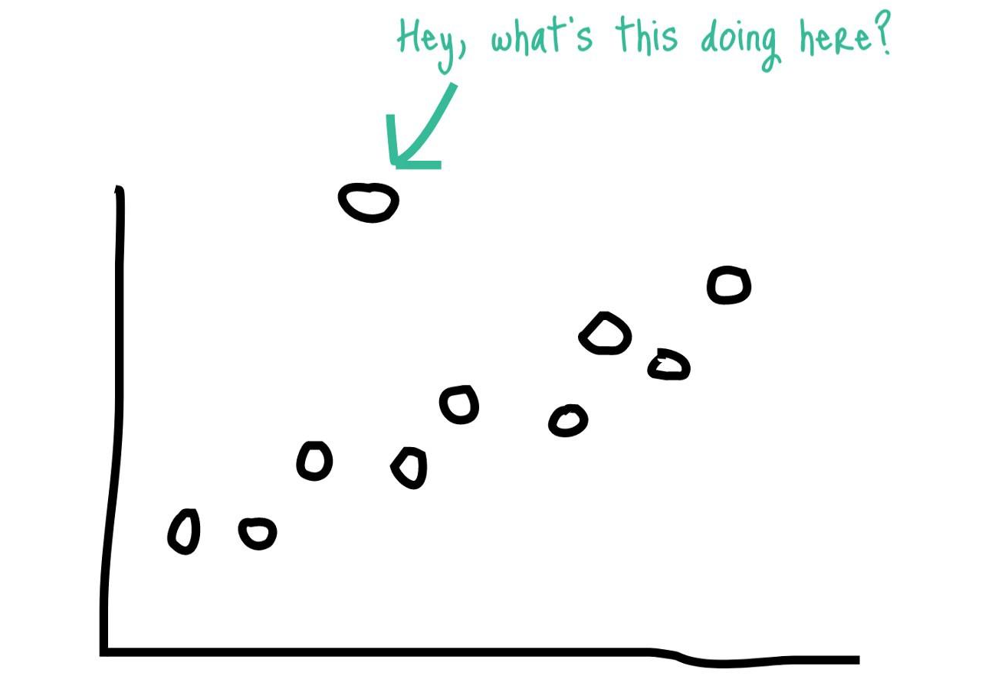
Example
Suppose you have a sample of 1000 people, and amongst them all have to choose one colour between Red and Blue. If 999 choose Red and only one person chooses Blue, I would say that that person is an outlier for that sample.
Suppose you do customer profiling and find out that the average annual income of customers is $0.8 million. But, there are two customers having annual income of $4 and $4.2 million. These two customers annual income is much higher than rest of the population. These two observations will be seen as Outliers.

Slide 16
How to handle outliers?
Drop the outlier records
Cap your outliers data
For example, if you’re using income, you might find that people above a certain income level behave in the same way as those with a lower income. In this case, you can cap the income value at a level that keeps that intact.
Assign a new value:
If an outlier seems to be due to a mistake in your data, you try imputing a value. Common imputation methods include using the mean of a variable or utilizing a regression model to predict the missing value.

Slide 17
Why data cleaning is important?
Cleaning and Transforming to get, high-quality data.
No quality data, no quality decisions!
Quality decisions must be based on good quality data (e.g., duplicate or missing data may cause incorrect or even misleading statistics)

Slide 18
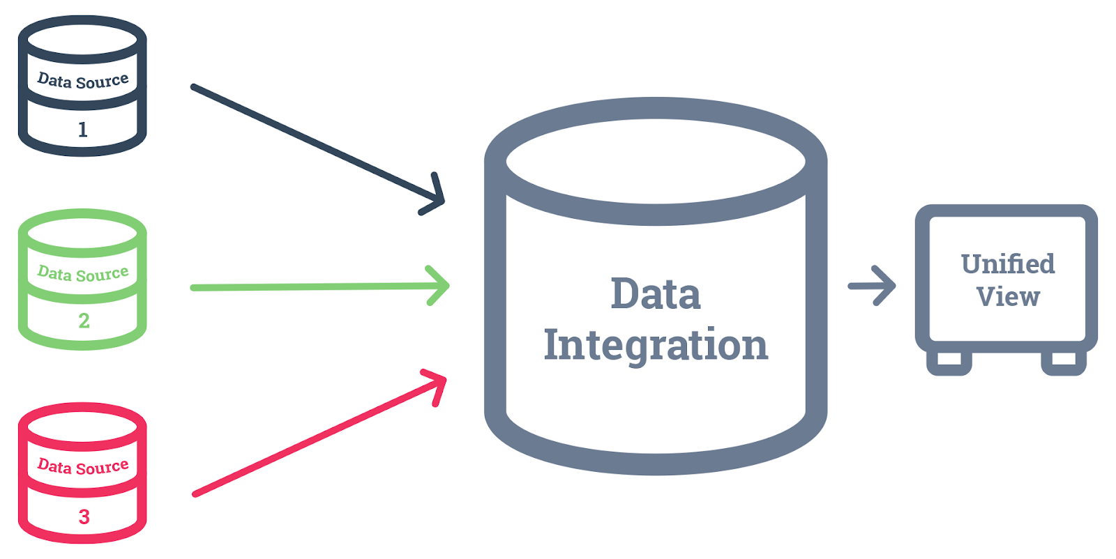
Data Preprocessing - Data Integration
In simple terms, data integration is like gathering information from different places, putting it together, and creating a clearer and more useful picture that helps in making smarter decisions. It's a crucial aspect of data science because having a comprehensive and integrated dataset allows for more accurate analysis and insight
Is the process of gathering data from various sources and combine them to form consistent dataset.
This consistent data is used for Data Preparation and analysis.
Source: https://blog.hurree.co/blog/data-integration-in-marketing

Slide 19
Data Preprocessing - Data Transformation
Consider a dataset with two features: "Age" (ranging from 0 to 100) and "Income" (ranging from 20,000 to 100,000). To normalize these features, you can use the Min-Max scaling formula:
Normalized Value=Original Value−Min ValueMax Value−Min Value
Normalized Value=
Max Value−Min Value
Original Value−Min Value
​
After normalization, both "Age" and "Income" values will be within the range of 0 to 1, making them comparable
Example:
Consider a dataset with individual features for daily rainfall, temperature, and humidity. Instead of using these individual features, you might aggregate them into a single feature like "Weather Score" that considers all these factors collectively. This simplifies the dataset while retaining essential information.
Convert the raw data into a specified format according to the need of the model
The options for the transformation of data are given below –
Normalization/Feature Scaling – In this method, numerical data is converted into the specified range, i.e., between 0 and one so that scaling of data can be performed.
Aggregation – The concept can be derived from the word itself, this method is used to combine the features into one. For example, combining two categories can be used to form a new group.
Generalization – In this case, lower level attributes are converted to a higher standard.
Suppose you have a dataset with specific car models, each associated with various attributes like make, model, year, and color. Generalizing this dataset might involve creating a higher-level attribute like "Vehicle Type" based on common characteristics. So, a sedan, SUV, and convertible could all be generalized into the "Vehicle Type" category.

Slide 20
Data Preprocessing - Data Reduction
Reduce the data size by:
Aggregating.
Eliminating redundant features.
Clustering.
Notes:
Consider a dataset with daily temperature readings. Instead of keeping individual daily readings, you might aggregate the data to represent weekly or monthly average temperatures. This reduces the number of data points while retaining essential information
In a dataset containing both temperature in Celsius and Fahrenheit, these two features are redundant because they provide the same information. Removing one of them reduces redundancy and simplifies the dataset.
Consider a dataset with customer information, including age, income, and purchase history. By applying clustering algorithms, you can group similar customers into clusters based on their characteristics. This reduces the dataset size by representing each cluster with a summary or centroid, making it more manageable

Slide 21
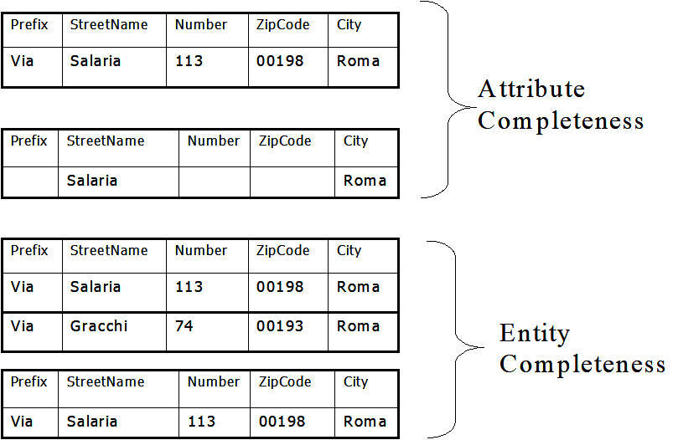
Data Quality Dimensions
Accuracy
Example:”Jhn” vs. “John”
Currency
Example: Residence (Permanent) Address: outdated vs. up-to-dated
Consistency
Example: ZIP Code and City consistent
Completeness
Partial knowledge of the records in a table or of the attributes in a record

Slide 22
Why is Data Preprocessing Important?
Real-world data is generally:
Incomplete
Noisy
Inconsistent
Improves the quality of data.
Important step before modelling.

Slide 23

Reading for this week
2.3 - Data Preparation
2.3.1 Data Cleaning
2.4 Missing Values
2.4.1 Discard Instances
2.4.2 Replace by most Frequent/Average Value
Link

